Slide 1

Experiment 4 : Thermistor Interface with Arduino

Slide 2
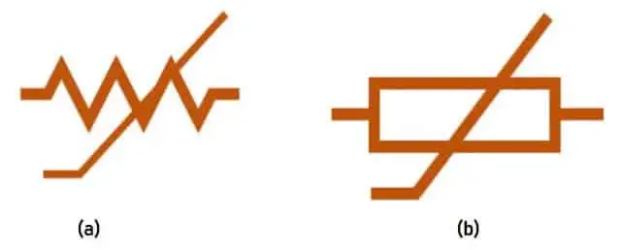
Thermistor
The word “Thermistor” is a combination of the words “Thermal” and “resistor“. A thermistor is a type of resistor whose resistance changes with the change in temperature.
It is a passive component that does not require an extra power source to operate.
They are inexpensive and easy accessible.
There are two types of thermistors:
PTC (Positive Temperature Coefficient) Thermistor
NTC (Negative Temperature Coefficient) Thermistor

Slide 3
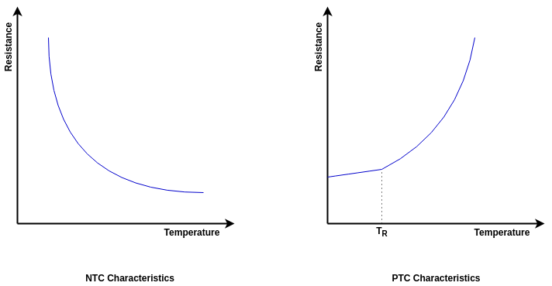
POSITIVE TEMPERATURE COEFFICIENT (PTC)THERMISTOR
PTC or Positive Temperature Coefficient thermistor resistance is directly proportional to the surrounding temperature.
Its resistance increases with an increase in the temperature and decreases with a decrease in the temperature.

Slide 4
NEGATIVE TEMPERATURE COEFFICIENT (NTC)THERMISTOR
NTC or Negative temperature coefficient thermistor has a negative coefficient k. therefore, its resistance varies inversely with the temperature.
The resistance decreases with an increase in temperature and vice versa

Slide 5
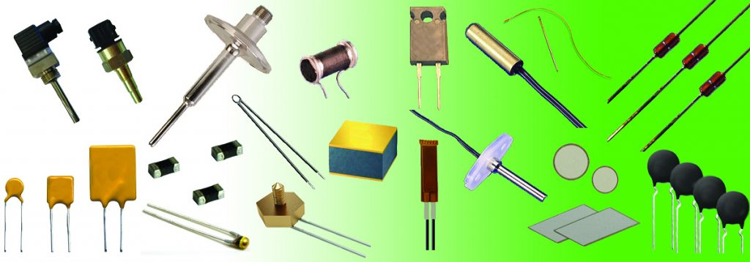
Thermistor

Slide 6
In experiment 1, 2 & 3, we have learned
How to use pinMode command
How to use digitalWrite command
How to declare variables using int, define
How to use digitalRead command
How to do serial communication
How to use analogWrite command
How to use analogRead command
In experiment 4, we are going to learn
How to use mathematical formulae
How to use If, elseif, for loop statements.
How to declare variables using float

Slide 7
Aim
The main objective of this experiment is
To interface thermistor with Arduino UNO, to read thermistor data and print on the Serial Monitor.
To turn on LED if temperature is more than 30 ºC.
To turn off both LED1, LED2 if temperature is less than 85 ºF, to turn on LED1 if temperature is between 85 ºF to 95 ºF, and to turn on both LED1, LED2 if temperature is more than 95 ºF.

Slide 8
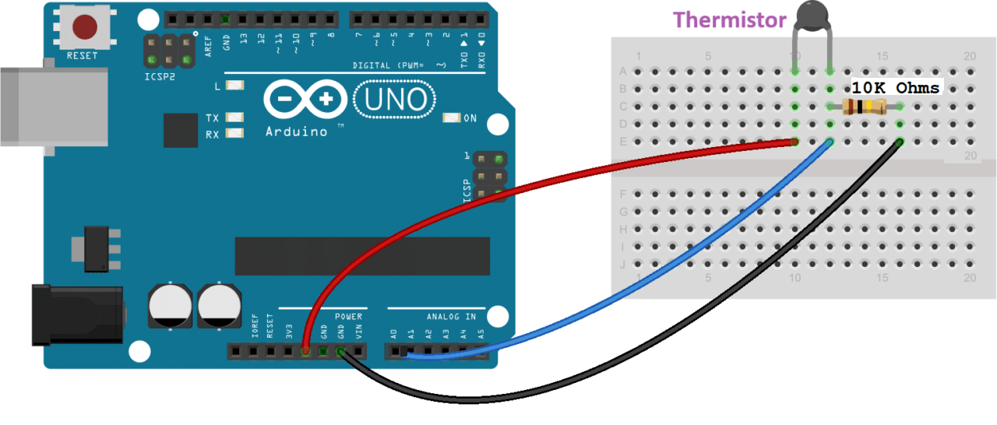
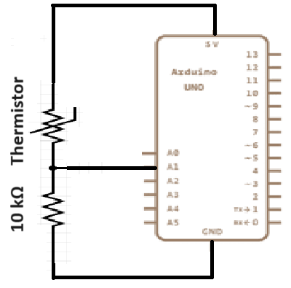
Circuit Connections: Objective 4(a)

Slide 9



Value Convertions

Slide 10

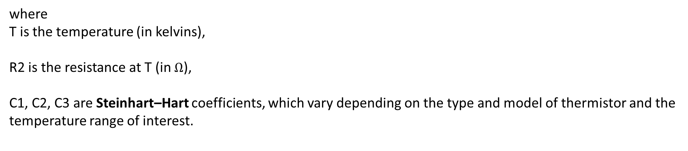
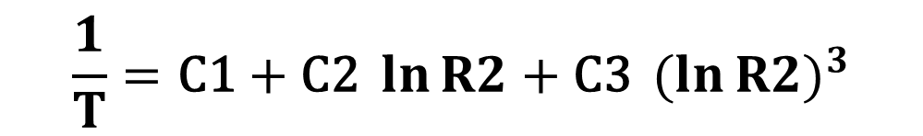
Value Convertions
$$\frac{1}{T}=\text{C}\text{1}+\text{C}\text{2 }\ln{R2}+\text{C}\text{3 }{(ln{R2)}}^{3}$$
Steinhart–Hart Equation
where
T is the temperature (in kelvins),
R2 is the resistance at T (in $Ω$),
C1, C2, C3 are Steinhart–Hart coefficients, which vary depending on the type and model of thermistor and the temperature range of interest.
Kelvin to Celsius Temperature Convertion
$$T \left(oC\right)=T \left(oK\right)−\text{273.15}$$
$$T \left(oF\right)=\left(T \left(oC\right)∗ \frac{9}{5}\right)+\text{32}$$
Celsius to Fahrenheit Temperature Convertion

Slide 11
Program: Objective 4(a)
float Vo = 0;
float R1 = 10000;
float R2, T_Kelvin, T_Celsius, T_Fahrenheit;
float c1 = 1.009249522e-03;
float c2 = 2.378405444e-04;
float c3 = 2.019202697e-07;
void setup()
{
Serial.begin(9600);
}
void loop()
{
Vo = analogRead(A1);
R2 = R1 * ((1023.0 / Vo) - 1.0);
T_Kelvin=(1.0/(c1+c2*log(R2)+c3*log(R2)*log(R2)*log(R2)));
T_Celsius = T_Kelvin - 273.15;
T_Fahrenheit = (T_Celsius * 9.0)/ 5.0 + 32.0;
Serial.print("Resistance: ");
Serial.print(R2);
Serial.println(" Ohms");
Serial.print("Temperature: ");
Serial.print(T_Kelvin);
Serial.println(" Kelvin");
Serial.print("Temperature: ");
Serial.print(T_Celsius);
Serial.println(" Celsius");
Serial.print("Temperature: ");
Serial.print(T_Fahrenheit);
Serial.println(" Fahrenheit");
delay(2000);
}

Slide 12
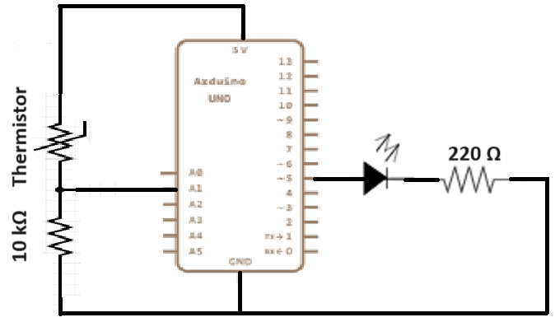
Circuit Connections: Objective 4(b)

Slide 13
Objective 2
Serial.print("Resistance: ");
Serial.print(R2);
Serial.println(" Ohms");
Serial.print("Temperature: ");
Serial.print(T_Kelvin);
Serial.println(" Kelvin");
Serial.print("Temperature: ");
Serial.print(T_Celsius);
Serial.println(" Celsius");
Serial.print("Temperature: ");
Serial.print(T_Fahrenheit);
Serial.println(" Fahrenheit");
if (T_Celsius>=30)
{
digitalWrite(13,HIGH);
delay(1000);
}
delay(1000);
}
float Vo = 0;
float R1 = 10000;
float R2, T_Kelvin, T_Celsius, T_Fahrenheit;
float c1 = 1.009249522e-03;
float c2 = 2.378405444e-04;
float c3 = 2.019202697e-07;
void setup()
{
Serial.begin(9600);
pinMode(13,OUTPUT);
}
void loop()
{
Vo = analogRead(A1);
R2 = R1 * ((1023.0 / Vo) - 1.0);
T_Kelvin = (1.0/(c1+c2*log(R2)+c3*log(R2)*log(R2)*log(R2)));
T_Celsius = T_Kelvin - 273.15;
T_Fahrenheit = (T_Celsius * 9.0)/ 5.0 + 32.0;

Slide 14
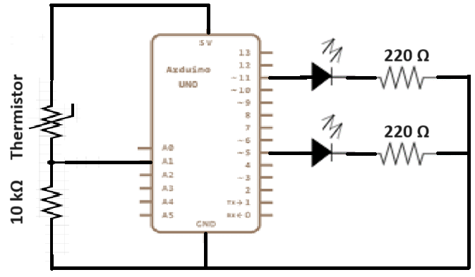
Circuit Connections: Objective 4(c)

Slide 15
V0=analogRead(A0);
RT = R1*((1023.0/V0) -1.0);
T_Kelvin = (1.0/(c1+c2*log(RT)+c3*log(RT)*log(RT)*log(RT)));
T_Celsius=T_Kelvin-273.15;
T_Fahrenheit=(T_Celsius*9.0)/5.0+32.0;
if(T_Fahrenheit<=95)
{ digitalWrite(13,LOW);
digitalWrite(7,LOW);
delay(1000);
}
else if(T_Fahrenheit>=95 && T_Fahrenheit<=99)
{
digitalWrite(13,HIGH);
digitalWrite(7,LOW);
delay(1000);
}
else
{
digitalWrite(13,HIGH);
digitalWrite(7,HIGH);
delay(1000);
}
float V0=0;
float R1 = 10000;
float RT;
float T_Kelvin, T_Celsius;
float T_Fahrenheit;
float c1=1.009249522e-03;
float c2=2.378405444e-04;
float c3=2.019202697e-07;
void setup()
{
Serial.begin(9600);
pinMode(13,OUTPUT);
pinMode(7,OUTPUT);
}
void loop()
{
Serial.print(" Thermal Resistance:");
Serial.print(RT);
Serial.println(" Ohms");
Serial.println(" Temparature:");
Serial.print(T_Kelvin);
Serial.println(" kelvin");
Serial.print(" Temparature:");
Serial.print(T_Celsius);
Serial.println(" celsius");
Serial.print("Temparature:");
Serial.print(T_Fahrenheit);
Serial.println(" Fahrenheit");
delay(1000);
}

Slide 16
Self Assessment Questions
What is a thermistor?
How can we convert the analog reading from the thermistor into temperature values?
What is the purpose of the resistor connected in the circuit with the thermistor?
What are some applications of temperature measurement using a thermistor and Arduino UNO?

Slide 17
THANK YOU
Team – Fundamentals of IoT & Sensors

